Slide 1
6LoWPAN
Umesh D. Patil.
Project Engineer
CDAC-Hyderabad

Slide 2
6LoWPAN
6LoWPAN is an acronym of IPv6 over Low -Power Wireless Personal Area Networks.
The 6LoWPAN concept originated from the idea that "the Internet Protocol could and should be applied even to the smallest devices," and that low-power devices with limited processing capabilities should be able to participate in the Internet of Things.
Devices in the network typically work together to connect the physical environment to real world applications, e.g., wireless sensors networks
Wireless Sensor Networks (WSN) adopts IEEE 802.15.4 standard which specifies the characteristic of a wireless link for low-power personal area networks
Common topologies include – star, mesh, and combinations of star and mesh.

Slide 3
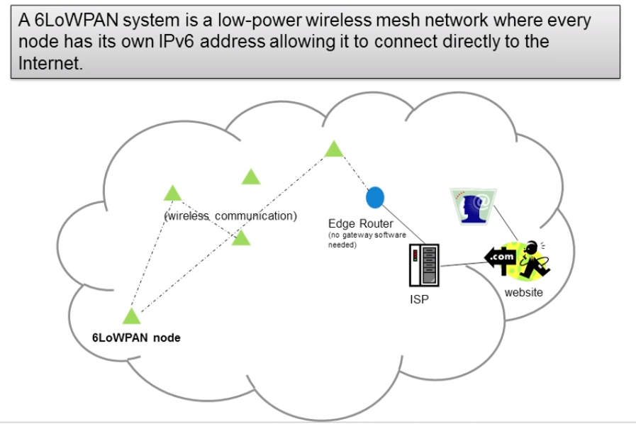

Slide 4
6LoWPAN characteristics
Small packet size
16-bit short or IEEE 64-bit extended media access control addresses
Low bandwidth. (250/40/20 kbps)
Topologies include star and mesh
Low power, typically battery operated
Relatively low cost
Networks are ad hoc & devices have limited accessibility and user interfaces

Slide 5
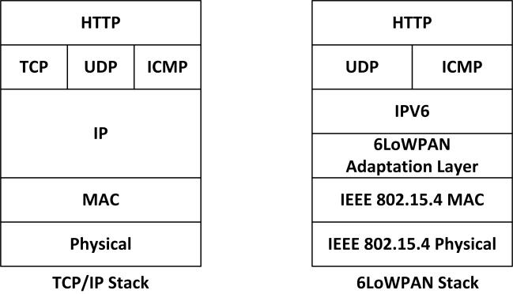
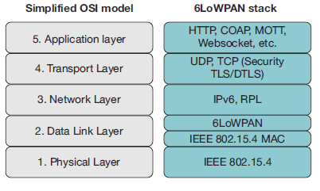
6LoWPAN ARCHITECTURE

Slide 6
6LoWPAN ARCHITECTURE
The Physical (PHY) layer provides the basic communication capabilities of the medium.
The key function of PHY data services is to provide transmission and reception of data packets between MAC and PHY through the physical radio channel.
The PHY management service interface, offers access to every layer management function and maintains a database of information on related personal area networks.
The Data Link layer provides services to enable reliable, single-hop communication links between 6LoWPAN nodes.
The MAC Protocol Data Unit (PDU) is IEEE 802.15.4 compliant which operates in non beacon-enabled mode.
In non-beacon - enabled networks, data frames (including those carrying IPv6 packets) are transmitted via the contention-based channel access method such as un-slotted CSMA/CA.

Slide 7
Adaptation Layer
The adaptation layer is the main component of 6LoWPAN.
The major function of this layer is the TCP/IP header compression.
To enable the efficient transmission of payload, header compression is mandatory.
The IEEE 802.15.4 frame has a maximum packet size of 128 bytes, whereas IPv6 header size is 40 bytes, User Datagram Protocol (UDP) and Internet Control Message Protocol (ICMP) header sizes are both 4 bytes, fragmentation header adds another 5 bytes overhead. However, without compression, it is not possible to transmit any payload effectively.
A second major function of the adaptation layer is to handle packet fragmentation and reassembling
IEEE 802.15.4 has a maximum frame size of 128 bytes, while IPv6 requires a maximum transmission unit (MTU) of 1280 bytes. This mismatch is handled in the adaptation layer.

Slide 8
Adaptation Layer
The next major function of the adaptation layer is routing
The 6LoWPAN network layer provides the internetworking capability to sensor nodes. The main considerations of this layer are addressing, mapping and routing protocols.

Slide 9
Brief overview of Packet Transmission
The payload packet is encapsulated with IP header. Later, IP packet is fragmented and is sent to the next hop node based on routing table information.
when the adaptation layer in the next hop receives all the fragments successfully, it creates an IP packet from fragments and forwards it to the network layer. Further, the network layer sends the packet to the upper layer (transport layer), conditional tothe desired destination being reached.
Otherwise, it forwards the packet to the next hop node according to the routing table information.
Whenever fragment loss is encountered, all fragments are retransmitted to one hop distance

Slide 10
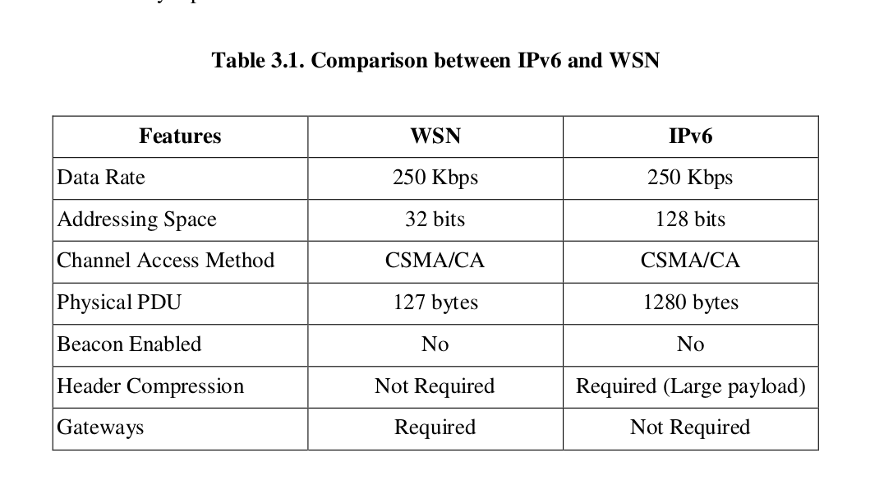
Comparison between IPv6 and WSN

Slide 11
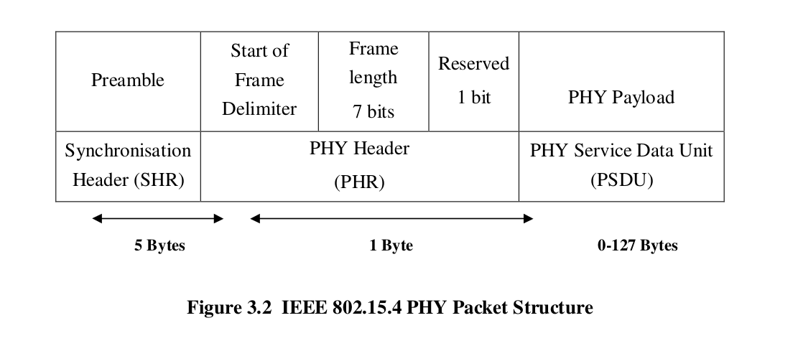
PHY Packet Structure

Slide 12
PHY Packet Structure
The PHY data structure is divided into PHY header field and the PHY payload field.
It consists of Synchronization Header (SHR), PHY Header (PHR) and Physical Service Data Unit (PSDU).
The Synchronizations header encompasses various fields:
Preamble Sequence,
Start of Frame Delimiter
Frame length field
The Physical header is the reserved field indexed with one bit.
The SHR wants the receiver to achieve symbol synchronization. As a result, the SHR, PHR, and PHY payload form PHY packet

Slide 13
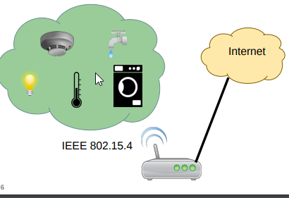
Applications
Equipment health monitoring
Environment monitoring
Security
Home
Building automation

Slide 14
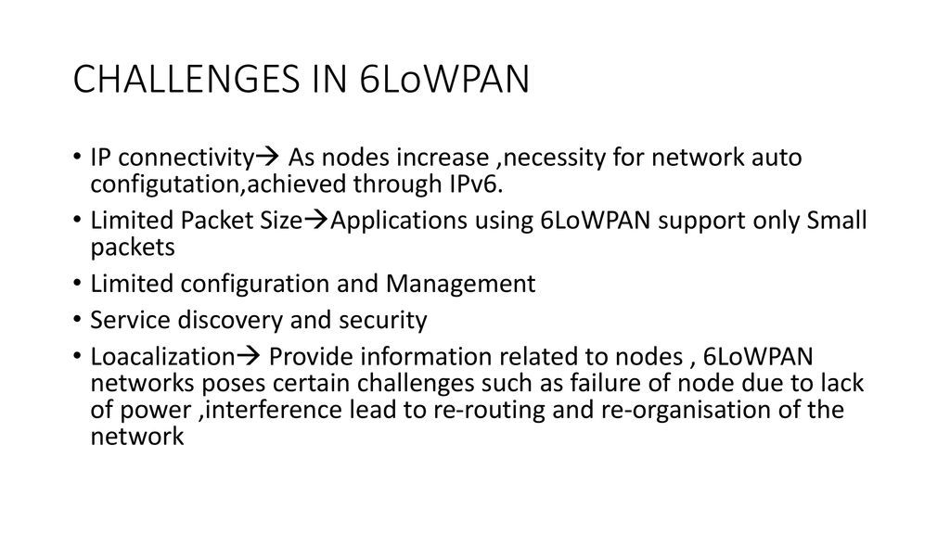

Slide 15
6LoWPAN Security
It is anticipated that the Internet of Things, IoT will offer hackers a huge opportunity to take control of poorly secured devices and also use them to help attack other networks and devices.
6LoWPAN uses AES-128 link layer security which is defined in IEEE 802.15.4 and this provides link authentication and encryption.
Further security is provided by the transport layer security mechanisms. This is defined in RFC 5246 and runs over TCP/IP protocol .
Basic requirements for 6LoWPAN :
The device must have sleep mode in order to support battery saving.
Minimal memory requirements.
Routing overhead should be lower.

Slide 16
Advantages of 6LoWPAN :
One clear advantage with 6LoWPAN is the low power consumption and the meshing capability, enabling the wide dispersion of battery or battery-less sensor nodes into the field.
In addition, as this technology is evolving, so does the 6LoWPAN system along with it will evolve more
Support robust , self healing and scalable mesh networking.
Works efficiently with open IP standardized including UDP , TCP , COAP , HTTP , MQTT and web sockets.
In this network leaf nodes can be in sleep mode for a long duration of time.
It also offers one to many and many to one routing.
It offers end to end IP addressable devices which don’t require any gateway , only a router which can connect this network to IP.

Slide 17
REST

Slide 18
What is REST
Definition:
REpresentational State Transfer(REST) is a software architecture style that defines a set of constraints to be used for creating web services.
RESTful web services allow the requesting systems to access and manipulate textual representations of web resources by using a uniform & predefined set of stateless operations.
REST is basically a set of rules for communication between client and server.

Slide 19
Constraints on the definition of REST
There are six architectural constraints which makes any web service are listed below:
Uniform Interface
It is a key constraint that differentiate between a REST API and Non-REST API. It suggests that there should be an uniform way of interacting with a given server irrespective of device or type of application (website, mobile app).
Stateless
It means that the necessary state to handle the request is contained within the request itself and server would not store anything related to the session.
In REST, the client must include all information for the server to fulfill the request whether as a part of query params, headers or URI.
Cacheable
Every response should include whether the response is cacheable or not and for how much duration responses can be cached at the client side.

Slide 20
Constraints on the definition of REST
- Client will return the data from its cache for any subsequent request and there would be no need to send the request again to the server
Client-Server
REST application should have a client-server architecture. A Client is someone who is requesting resources and are not concerned with data storage, which remains internal to each server, and server is someone who holds the resources and are not concerned with the user interface or user state.
Layered System
An application architecture needs to be composed of multiple layers. Each layer doesn’t know any thing about any layer other than that of immediate layer and there can be lot of intermediate servers between client and the end server
Code on Demand
It is an optional feature. According to this, servers can also provide executable code to the client

Slide 21
Anatomy of REST
Data can be requested by the client and the server will respond appropriately.
Endpoint : URL where the REST server is listening.
Method :
GET : Get resource from server.
POST : Create resource to the server.
PATCH or PUT : Update existing resource from the server.
DELETE : Delete existing resource from the server.
Headers : The additional details provided for communication between client and server.
Data : Contains information you want to send to the server.

Slide 22
Requests & Responses
REQUEST
GET /news/ HTTP/1.1
Host: example.org
Accept-Encoding: compress, gzip
User-Agent: Python-httplib2
Here is a GET request to «http://example.org/news/»
Method = GET

Slide 23
Requests & Responses
And here is the response…
RESPONSE
HTTP/1.1 200 Ok
Date: Thu, 07 Aug 2008 15:06:24 GMT
Server: Apache
ETag: "85a1b765e8c01dbf872651d7a5"
Content-Type: text/html
Cache-Control: max-age=3600
<!DOCTYPE HTML>
...

Slide 24
Thank You…!!!

